Slide 1
Object-Oriented Design
Assignment 1 (Use Cases)
By: Group 13
Nopphiphat Suraminitkul (Nopi)
Ayush Singh
Juhi Sinha
Somnath Jogelkar

Slide 2
List of Actors
System (Application): The job of the system is to grant all the actors, including the moderator, family & friends and movie server access/permission to execute use cases/tasks.
Moderator (Admin): Moderator is the actor who is taking care of all the administrative tasks. That includes inviting people to join a group, managing polls, populate movie list to name a few.
Friends & Family (Participants): We are combining both friends & family as one actor where they essentially serve as customers in the group. As a part of their functionality they shall join the group, browse the movies, vote for movies to name a few.
Movie Server API: An API to pull the movie list from. The movie server has the movie list that will be populated by the moderator.

Slide 3
List of Use Cases (Moderator)
Moderator creates group: The moderator shall create a movie watcher’s group.
Moderator sends invitation: The moderator shall send an invitations to family and friends to join the group that they are invited to.
Moderator pull movies list: The moderator shall extract a list of movies that the family and friends shall browse from an external movie server. It’s similar to the process of extraction in an ETL process
Moderator populate movie links: The moderator shall populate the movies list (including links) into the group for family and friends to browse or search.
Moderator populate movie trailer links: The moderator shall populate the movie trailers links along with movies list into the group for family and friends to browse or search and watch.
Moderator populate movie review links: The moderator shall populate the movie review links along with movies list into the group for family and friends to browse or search and read.
Moderator create movie watching event: The moderator shall create a movie watching event that already has a pre-specified date and time of movie screening.
Moderator opening polling periods: The moderator has the ability to set (open) polling time frame for a specific poll posted under a movie watching event.
Moderator closing polling periods: The moderator has the ability to set (close) polling time frame for a specific poll posted under a movie watching event.

Slide 4
List of Use Cases (Family & Friends)
Family & friends join group : Family & friends shall accept the invitation to join a group.
Family & friends unsubscribe from group : Family & friends shall be able to unsubscribe from the group.
Family & friends search movies : Family & friends shall be able to search a particular movie from the list of movies.
Family & friends watch trailers : Family & friends shall be able to watch a trailer after they select a particular movie from the list of movies.
Family & friends read movie reviews : Family & friends shall be able to view the review after they select a particular movie from the list of movies.
Family & friends get polling notification : Family & friends shall receive a polling notification for the list of movies.
Family & friends vote for movie : Family & friends shall be able to vote for a particular movie from the list of movies.
Family & friends modify vote : Family & friends shall be able to modify their votes during the polling period before the pre-specified closing date and time.
Family & friends get winner notification : Family & friends shall be notified of the movie that won the poll.
Family & friends access movie history : Family & friends shall be able to access their history of movies viewed.

Slide 5
List of Use Cases (Movie Server)
Movie Server Grants Access to List of Movies: Movie Server gives access of the list of movies to the moderator

Slide 6
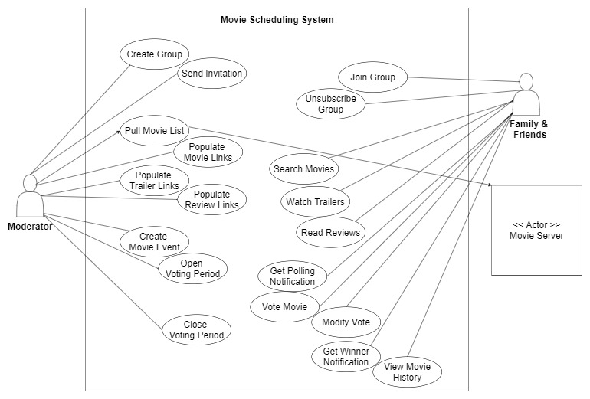
Use Case Diagram

